Slide 1

Diggibyte

Slide 2
Python basic syntax and Built-in operators

Slide 3
Python basic syntax
What is Syntax ?
Before we move on to understanding its syntax, let’s understand how to write and run a basic python program.
There are two ways to do so:
1.Interactive mode – In this mode, you write and execute the program
2.Script mode – In this mode, you first create a file (.py file), save it and then execute it.
Enter the following command in your terminal after installing Python to enter the interactive mode.
$ python
You have now entered the interactive mode. You can run any of the python statements in the interactive mode in the terminal now. But if you’re using a script editor / IDE, you do not have to do the same.
Print Statement:
Print(“syntax of print)

Slide 4
Indentation in Python
Whenever we write any piece of code in python, say, functions or loops, we specify blocks of code for them. How will we identify which block is for what? It is done by “indenting” statements of that block.
Syntax:
def fun_name():
statement
Rules:
Indentation cannot be split into multiple lines with the use of the backslash (‘\’) character
An IndentationError will be thrown if you try to indent the first line of code in python. You cannot indent the first line of code.
If you have indented your code either by using a tab or space, it’s recommended to continue with the same spacing preference throughout your code.
Do not use a mix of tabs and whitespaces to do so, as it may cause the wrong indentation.
It is best to use 1 tab (or 4 whitespaces) for the first level of indentation and continue adding 4 more whitespaces (or 1 more tab) for higher indentation levels.

Slide 5
Python Syntax Identifiers
What are identifiers?
It is a name given to something to differentiate it from other code entities.
Rules of identifiers:
The identifier will contain a combination of lowercase (a-z) or uppercase(A-Z) alphabets or numbers (0-9) or underscore (_)
The Identifier cannot start with a digit
Any reserved words or keywords cannot be used as identifier names (you’ll read more about keywords in the article soon)
Symbols or Special characters cannot be used in the identifier
Length of the identifier can be variable; there is no restriction
Remember that python is a case sensitive language, so var and VAR are two different identifiers
Examples of correct naming: var, Robot, python_007
Examples of incorrect naming: 97learning, hel!o
To check if your name is a valid identifier or not, you can use the inbuilt function “isidentifier()”.

Slide 6
Python Keywords
They are some unique purpose words that can be used only for specific cases and not as identifiers is called keywords in python.
To view all the keywords your version of python supports, you can open your script editor or IDE or write the following two commands on your terminal to list all the keywords.
Syntax:
import keyword
print(keyword.kwlist)
Python variables
What are variables?
To store any data values, we use containers called variables. There is no specific command in python to declare a variable. A variable is created the moment a value is assigned to it.
Example:
Var_1 = “variable”
X = 0

Slide 7
Comments in Python
comments are an integral part. We can make multiple line comments as docstrings or single-line comments.
Single line comment is denoted by # symbol
Example;
# this is a comment
Multi line comment is denoted by “”” or # each line
Example:
""“
It makes multiline
comments in Python
much easier
""“

Slide 8
Multiple Line Statements
Before understanding multiline statements, let us take a look at statements.
Each of these lines is a statement. What if some statements are lengthy and you cannot fit them properly in one line? That’s when multiline comments come in handy.
Using the continuation character backslash, you can explicitly divide a statement into multiple lines (“\”).
Example:
message = "This is a long statement that I want to write, but the " \
"problem is that it doesn't fit in one single line. So this is how " \
"I've written it for readability."
We can also write multiple statements in one line.
Example: a = 1; b = 2; c = 3

Slide 9
Quotations in python
Three types are used when it comes to quotation marks accepted by Python.
Single – ' ' Double – " " And Triple – " " " … " " "
We have already seen the usage of the triple quotation marks in the comments section. The single and double quotations are used to declare strings in Python
Blank Lines in Python
There are three ways to print blank lines in python.
The first and simplest way is to use a blank print statement:
Example:
Using single or double quotation marks
print('')
print("")

Slide 10
Waiting for user
Taking input in the Python programming language is done by the input() function. The program with input() function will not run till the program is not provided input by the user through the console.
Example:
name = input()

Slide 11
Python operators

Slide 12
Python Operators
What are operators in python?
Operators are special symbols in Python that carry out arithmetic or logical computation. The value that the operator operates on is called the operand.
Operators are used to perform operations on variables and values.
Python divides the operators in the following groups:
Arithmetic operators
Assignment operators
Comparison operators
Logical operators
Identity operators
Membership operators
Bitwise operators

Slide 13
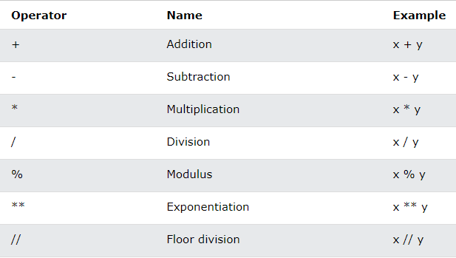
Python Arithmetic Operators
Arithmetic operators are used with numeric values to perform common mathematical operations.

Slide 14
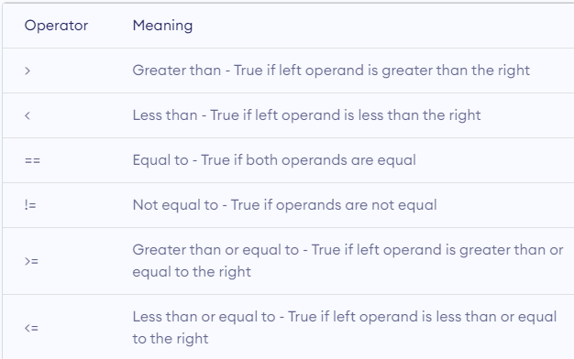
Comparison operators
Comparison operators are used to compare values. It returns either true or false according to the condition.

Slide 15
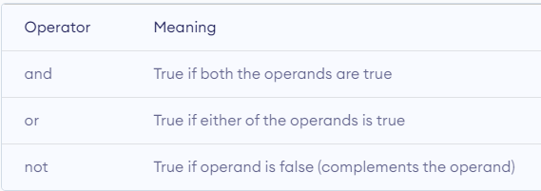
Logical operators
The result of the logical operator is used for the final decision making. Three different types of logical operators are available in python: The output of logical OR will be False only if both operands are False. If either of them has a True value, it will result True. The syntax ‘or’ is used for logical OR operation.
Example:
x = True
y = False
print('x and y is', x and y)
print('x or y is', x or y)
print('not x is', not x)

Slide 16
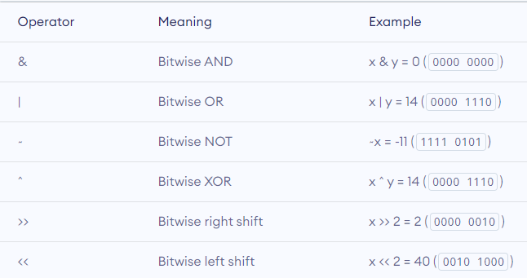
Bitwise operators
Bitwise operators act on operands as if they were strings of binary digits. They operate bit by bit, hence the name.

Slide 17
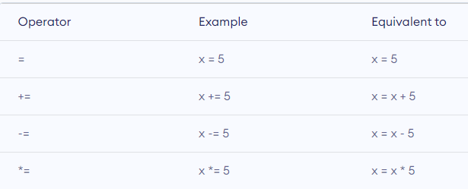
Assignment operator
Assignment operators are used in Python to assign values to variables.
a = 5 is a simple assignment operator that assigns the value 5 on the right to the variable a on the left.
There are various compound operators in Python like a += 5 that adds to the variable and later assigns the same. It is equivalent to a = a + 5

Slide 18
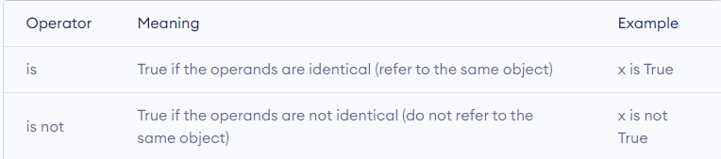
Special operator
Python language offers some special types of operators like the identity operator or the membership operator. They are described below with examples.
Identity operators:
is and is not are the identity operators in Python. They are used to check if two values (or variables) are located on the same part of the memory. Two variables that are equal does not imply that they are identical.

Slide 19
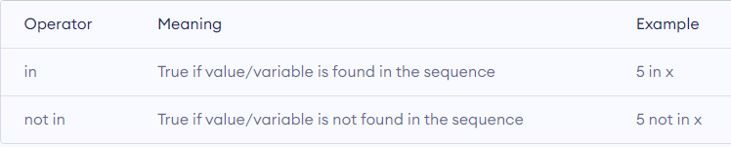
Membership operator
in and not in are the membership operators in Python. They are used to test whether a value or variable is found in a sequence.
(string, list, tuple, set and dictionary).
In a dictionary we can only test for presence of key, not the value.

Slide 20
STRINGS

Slide 21
Strings in Python
A string is a sequence of characters that can be a combination of letters, numbers, and special characters.
It can be declared in python by using single quotes, double quotes, or even triple quotes. These quotes are not a part of a string, they define only starting and ending of the string.
Strings are immutable, i.e., they cannot be changed. Each element of the string can be accessed using indexing or slicing operations.
Python string is the collection of the characters surrounded by single quotes, double quotes, or triple quotes. The computer does not understand the characters; internally, it stores manipulated character as the combination of the 0's and 1's.
Each character is encoded in the ASCII or Unicode character. So we can say that Python strings are also called the collection of Unicode characters.
In Python, strings can be created by enclosing the character or the sequence of characters in the quotes. Python allows us to use single quotes, double quotes, or triple quotes to create the string.

Slide 22
Syntax
str = "Hi Python !“
Str_1 = ‘Welcome to python training’
In Python, strings are treated as the sequence of characters, which means that Python doesn't support the character data-type; instead, a single character written as 'p' is treated as the string of length 1.

Slide 23
Creating String in Python
We can create a string by enclosing the characters in single-quotes or double- quotes. Python also provides triple-quotes to represent the string, but it is generally used for multiline string or docstrings.
#Using single quotes
str1 = 'Hello Python'
print(str1)
#Using double quotes
str2 = "Hello Python"
print(str2)
#Using triple quotes
str3 = '''''Triple quotes are generally used for
represent the multiline or
Docstring”””
print(str3)

Slide 24
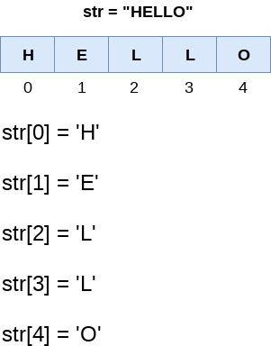
Strings indexing and splitting
Like other languages, the indexing of the Python strings starts from 0. For example, The string "HELLO" is indexed as given in the below figure.

Slide 25
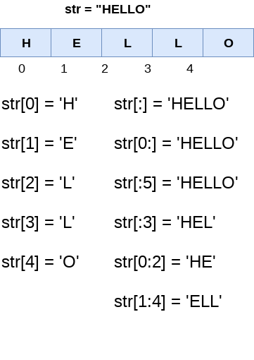
Slicing
The slice operator [] is used to access the individual characters of the string. However, we can use the : (colon) operator in Python to access the substring from the given string. Consider the following example.

Slide 26
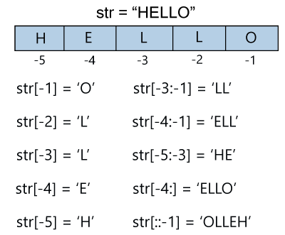
Reverse slicing
We can do the negative slicing in the string; it starts from the rightmost character, which is indicated as -1. The second rightmost index indicates -2, and so on. Consider the following image.

Slide 27
Reassigning Strings
Updating the content of the strings is as easy as assigning it to a new string. The string object doesn't support item assignment i.e., A string can only be replaced with new string since its content cannot be partially replaced. Strings are immutable in Python.
Example 1
str = "HELLO"
str[0] = “h"
print(str)

Slide 28
Deleting the String
As we know that strings are immutable. We cannot delete or remove the characters from the string. But we can delete the entire string using the del keyword.
Examples:
str = "JAVATPOINT"
del str[1]
Now we are deleting entire string.
str1 = "JAVATPOINT"
del str1
print(str1)

Slide 29
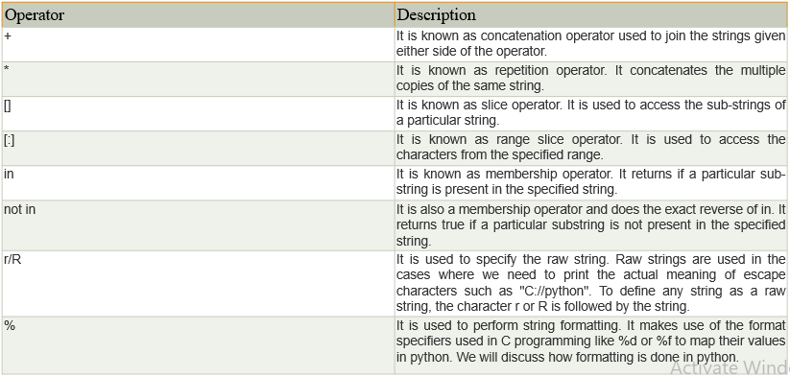
String Operators

Slide 30
Example:
Consider the following example to understand the real use of Python operators.
str = "Hello"
str1 = " world"
print(str*3) # prints HelloHelloHello
print(str+str1)# prints Hello world
print(str[4]) # prints o
print(str[2:4]); # prints ll
print('w' in str) # prints false as w is not present in str
print('wo' not in str1) # prints false as wo is present in str1.
print(r'C://python37') # prints C://python37 as it is written
print("The string str : %s"%(str)) # prints The string str : Hello

Slide 31
The format() method
The format() method is the most flexible and useful method in formatting strings. The curly braces {} are used as the placeholder in the string and replaced by the format() method argument. Let's have a look at the given an example: # Using Curly braces
print("{} and {} both are the best friend".format("Devansh","Abhishek"))
#Positional Argument
print("{1} and {0} best players ".format("Virat", "Rohit"))
#Keyword Argument
print("{a},{b},{c}".format(a = "James", b = "Peter", c = "Ricky"))

Slide 32
Python String Formatting Using % Operator
Python allows us to use the format specifiers used in C's printf statement. The format specifiers in Python are treated in the same way as they are treated in C. However, Python provides an additional operator %, which is used as an interface between the format specifiers and their values. In other words, we can say that it binds the format specifiers to the values. Integer = 10;
Float = 1.290
String = "Devansh"
print("Hi I am Integer ... My value is %d\nHi I am float ... My value is %f\nHi I am string ... My value is %s"%(Integer,Float,String))

Slide 33
PYTHON LISTS

Slide 34
Lists in Python
Lists are one of the most powerful data structures in python. Lists are sequenced data types. In Python, an empty list is created using list() function.
They are just like the arrays declared in other languages. But the most powerful thing is that list need not be always homogeneous.
A single list can contain strings, integers, as well as other objects. Lists can also be used for implementing stacks and queues. Lists are mutable, i.e., they can be altered once declared.
The elements of list can be accessed using indexing and slicing operations.

Slide 35
Characteristics of Lists
The list has the following characteristics:
The lists are ordered.
The element of the list can access by index.
The lists are the mutable type.
The lists are mutable types.
A list can store the number of various elements.

Slide 36
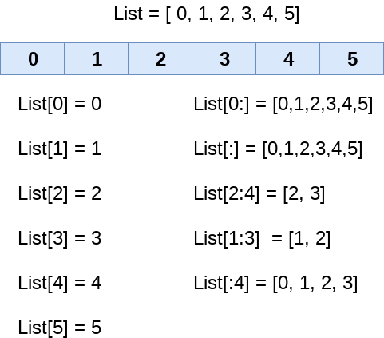
LIST INDEXING AND SLICING
The elements of the list can be accessed by using the slice operator [].
The index starts from 0 and goes to length - 1. The first element of the list is stored at the 0th index, the second element of the list is stored at the 1st index, and so on.

Slide 37
list_varible(start:stop:step)
The start denotes the starting index position of the list.
The stop denotes the last index position of the list.
The step is used to skip the nth element within a start:stop
Unlike other languages, Python provides the flexibility to use the negative indexing also. The negative indices are counted from the right. The last element (rightmost) of the list has the index -1; its adjacent left element is present at the index -2 and so on until the left-most elements are encountered.

Slide 38
Updating List values
Lists are the most versatile data structures in Python since they are mutable, and their values can be updated by using the slice and assignment operator.
Python also provides append() and insert() methods, which can be used to add values to the list.
list = [1, 2, 3, 4, 5, 6]
print(list)
# It will assign value to the value to the second index
list[2] = 10
print(list)
# Adding multiple-element
list[1:3] = [89, 78]
print(list)
# It will add value at the end of the list
list[-1] = 25
print(list)

Slide 39
The list elements can also be deleted by using the del keyword. Python also provides us the remove() method if we do not know which element is to be deleted from the list. Consider the following example to delete the list elements.
list = [1, 2, 3, 4, 5, 6]
print(list)
# It will assign value to the value to second index
list[2] = 10
print(list)
# Adding multiple element
list[1:3] = [89, 78]
print(list)
# It will add value at the end of the list
list[-1] = 25
print(list)

Slide 40
Iterate a list:
A list can be iterated by using a for - in loop. A simple list containing four strings, which can be iterated as follows list = ["John", "David", "James", "Jonathan"]
for i in list:
# The i variable will iterate over the elements of the List and contains each element in each iteration.
print(i)

Slide 41
Adding elements to the list:
Python provides append() function which is used to add an element to the list. However, the append() function can only add value to the end of the list.
#Declaring the empty list
l =[]
#Number of elements will be entered by the user
n = int(input("Enter the number of elements in the list:"))
# for loop to take the input
for i in range(0,n):
# The input is taken from the user and added to the list as the item
l.append(input("Enter the item:"))
print("printing the list items..")
# traversal loop to print the list items
for i in l:
print(i, end = " ")

Slide 42
Removing elements from list:
Python provides the remove() function which is used to remove the element from the list. list = [0,1,2,3,4]
print("printing original list: ");
for i in list:
print(i,end=" ")
list.remove(2)
print("\nprinting the list after the removal of first element...")
for i in list:
print(i,end=" ")

Slide 43
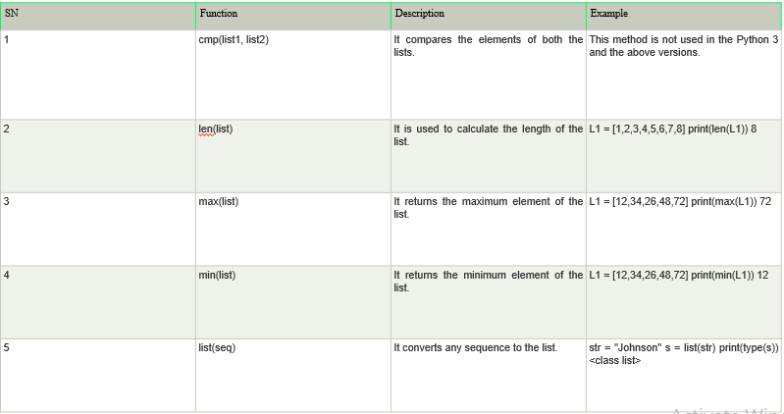

Slide 44
Manage Dependencies in Python

Slide 45
Python
pip
Python Interpreter
Python Virtual
Environment

Slide 46
Python Interpreter:
Python is an interpreter language.
It means it executes the code line by line.
Python provides a Python Shell, which is used to execute a single Python command and display the result.
So, the Python interpreter converts the code written in python language by the user to the language which computer hardware or system can understand.
It does all the time whenever you run your python script.

Slide 47
Dependency management
Dependencies:
Most ‘real world’ python programs use 3rd party libraries and frameworks. They are called dependencies.
Example:
my_program
super_library
other_dependency

Slide 48
Transitive Dependencies
“Dependencies of dependencies” : secondary dependencies
My_program
super_library
decent_library
tool_v2.
awesome_framework
other_dependency
mega_module

Slide 49
Managing dependencies is manually difficult
Time consuming
Copying/pasting source code makes update tedious
Easy to make mistakes
The solution: Package managers

Slide 50
Package
A package is a bundle of software to be installed into a python environment. Typically third party library and frameworks.
Eg:
Django
Numpy
Seaborn

Slide 51
Pip – Python Package Manager
Pip comes with modern python install
Virtual environment:
Will provide us a standalone version particularly for the project we are using.
So we can install the corresponding dependencies without affecting other projects. That’s how we manage dependencies in python

Slide 52






LET’S CONNECT
info@diggibyte.com
www.diggibyte.com
+91 81108 89199
Novel Tech Park, Ground Floor, Kudlu Gate, Bengaluru, Karnataka.
Pin Code: 560068

